Slide 1
Problem Solving with C++
The Object of Programming
Walter Savitch
Chapter 10
Strings and Multidimensional Arrays
Slides by David B. Teague, Western Carolina University,
A Constituent Institution of The University of North Carolina

Slide 2
Strings and Multidimensional Arrays
10
String Basics
  cstring Valules, cstring Variables, and ANSI C++ string class
  Predefined cstring Functions
  Defining cstring Funcitons
  cstring input and output
  cstring-to-Number Conversions and Robust Input
Multidimensional Arrays
  Multidimensional Array Basics
  Arrays of cstrings
The C++ Standard string class
  Interface for the Standard string class
  Arrays of string revisited
  Namespaces Revisited

Slide 3
Strings and Multidimensional Arrays
10
We will refer to strings we have dealt with so far as cstrings. ANSI C++ Library provides a string class which is introduced in this chapter. We refer to these as simply strings.
In this chapter we study the ANSI C++ string class and arrays with more than one index.
Arrays with more than one index called multidimensional arrays.

Slide 4
10.1 String Basics cstring Values and cstring Variables (1 of 5)
ANSI C++ Library provides a string class which is introduced in this chapter. We refer to these as strings.
We will refer to strings we have dealt with so far as cstrings.
Members of the C++ Standard Library’s a class string are declared in the header <string>.
Technically, cstrings are null terminated char arrays.
In the example,
char x[ ] = “Enter the input.”;
“Enter the input:” is a cstring literal. The variable x is a cstring.

Slide 5
cstring Values and cstring Variables (2 of 5)
A cstring variable is a partially filled array having base type char
Any array uses positions havinb index values 0 through one less than the number used.
The cstring variable signals the last used position by placing the special character, called the null character ‘\0’ in the array one position beyond the last character of the cstring.
If we declare and initialize a cstring variable s:
char s[10] ;
If s contains “Hi, Mom” then the array elements are:
s[0] s[1] s[2] s[3] s[4] s[5] s[6] s[7] s[8] s[9] s[10]
H i , M o m ! \0 ? ?
The character ‘\0’ is the sentinel marking the end of the cstring.

Slide 6
cstring Values and cstring Variables (3 of 5)
It is possible to initialize a cstring variable at declaration:
char my_message[20] = “Hi there.”;
Notice that cstring variables need not fill the array.
The compiler will count the characters in the initializing string and
add one for the null character:
char short_string[ ] = “abc”;
This is equivalent to
char short_string[4] = “abc”;
or
char short_string[4] = {‘a’, ‘b’, ‘c’, ‘\0’};
You must leave space for the null character when you specify size.

Slide 7
cstring Values and cstring Variables (4 of 5)
Do not confuse these situations:
char a_string[ ] = “abc”; // Inserts terminator ‘\0’
char not_a_string[4] = {‘a’, ‘b’, ‘c’}; // Does not insert ‘\0’
These are NOT equivalent.
The first of these of these initializations places the required null
terminating character ‘\0’ after the ‘a’, ‘b’, and ‘c’. The result is a
cstring.
The second leaves space for the ‘\0’ null character, but it does not insert the null character. The result is NOT a cstring.

Slide 8
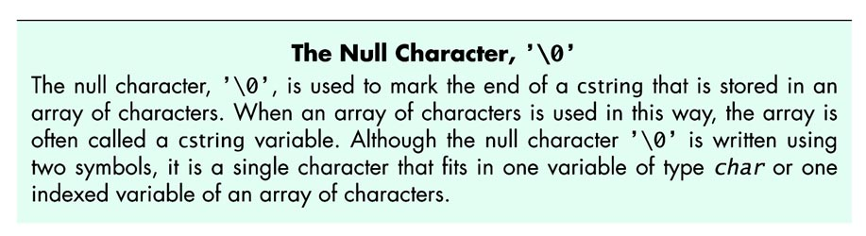
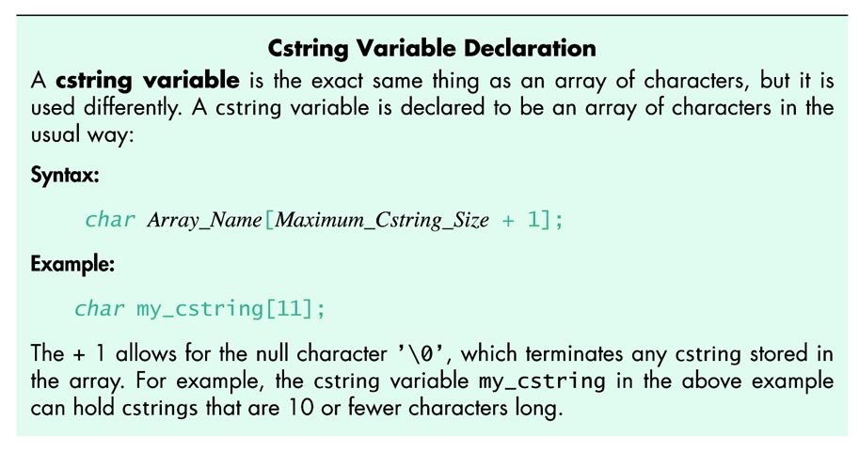
608_01

Slide 9
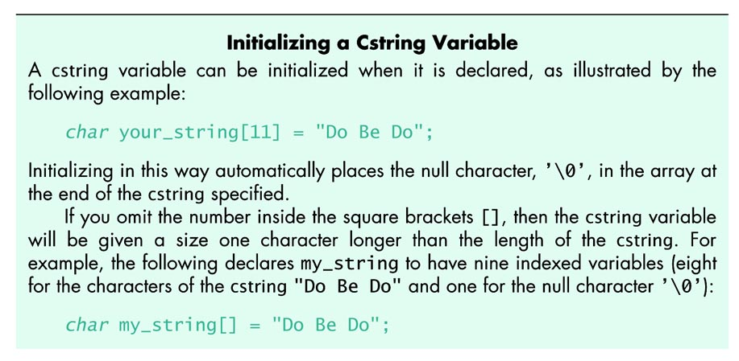
609

Slide 10
cstring Values and cstring Variables (5 of 5)
A cstring is an ordinary array with base type char, and may be
processed an element at a time:
This loop will change the cstring, our_string, into a cstring having the
same length but with characters all ‘X’:
int index = 0;
while (our_string[index] != ‘\0’)
{
our_string[index] = ‘X’;
index++;
}
In processing cstrings take great care not to overwrite the null character. An array that was a cstring that has its terminating character overwritten is NO LONGER a cstring.
In the loop above, if our_string has no null terminator, the loop will run off into memory, happily writing on every byte in memory beyond the end of our_string until a byte is found with zero value.

Slide 11
PITFALL:
Using = and == with cstrings (1 of 5)
Values and variables of type cstring when used with = (assignment) and == (comparison for equality) do not behave like built-in types.
Assigning a value to a cstring in the obvious way is illegal:
char a_string[10];
a_string = “hello”; // ILLEGAL
Initializing at declaration is straight forward:
char a_string[10] = “DoBeDo”;
The = does not mean assignment, in spite of the appearance.
In Chapter 11 we will see that in C++, assignment and initialization can have very different behavior.

Slide 12
PITFALL:
Using = and == with cstrings (2 of 5)
Assignment can be done barehanded, an element at a time:
char a_string[10] = "Hello";
char b_string[10];
int i = 0;
while(a_string[i] != ‘\0’)
b_string[i] = a_string[i];
There is a predefined function, strcpy, to assign cstrings:
char a_string[10] = "Hello";
char b_string[10];
strcpy(b_string, a_string);
The strcpy function is declared in the <cstring> header.

Slide 13
PITFALL:
Using = and == with cstrings (3 of 5)
Comparision of cstrings cannot be done with the == operator. The attempt to compare cstrings with == compiles, it does not get the results you expect.
Array names carry the address value of the first array element. The result of using == depends on where in memory the cstrings are stored.
We leave it to the student to compare strings barehanded, and illustrate use of the predefined comparison function strcmp.
char a_string[10] = "aeolean";
char b_string[10] = "aeonian";
if (strcmp(b_string, a_string))
cout << "The strings are NOT the same.";
else
cout << "The strings are the same.";
The strcmp function is declared in the <cstring> header.

Slide 14
PITFALL:
Using = and == with cstrings (4 of 5)
strcmp compares cstrings is in lexicographic order:
For successive values of i starting at 0, cstring1[i] and cstring2[i] are compared:
  If the characters are different:
    If cstring1[i] < cstring2[i] strcmp returns a negative number.
    If cstring1[i] > cstring2[i] , strcmp returns a positive number.
    The number may be -1 or +1, or the difference of the encoding
    (cstring1[i] - cstring2[i]), or some other value.
    The actual value returned depends on the implemenation.
    Do not write code that depends on the value returned.
    Testing then stops.
  If the cstrings are equal up to the end of one of them, the value returned indicates the longer string is greater than the shorter string.
  If the strings are equal in length and have the same characters, the strings are equal.

Slide 15
Predefined cstring Functions (5 of 5)
Display 10.1 (next slide) contains a few of the functions from the cstring library.
You must #include <cstring> to gain access to these functions.
strcpy(target, source) replaces target with source. Be sure there is enough space in target to hold all of source.
strcat(target, source) appends source to target. The first character of source is copied into the null terminator of target, and all successive characters of source are copied into target. Be sure there is enough space in target for all of source’s characters, including source’s null terminator.
strlen(source) returns the number of characters up to but not including the null terminator.
strcmp(str1, str2) We discussed this in an earlier slide. Refer to Display 10.1 for detail.

Slide 16
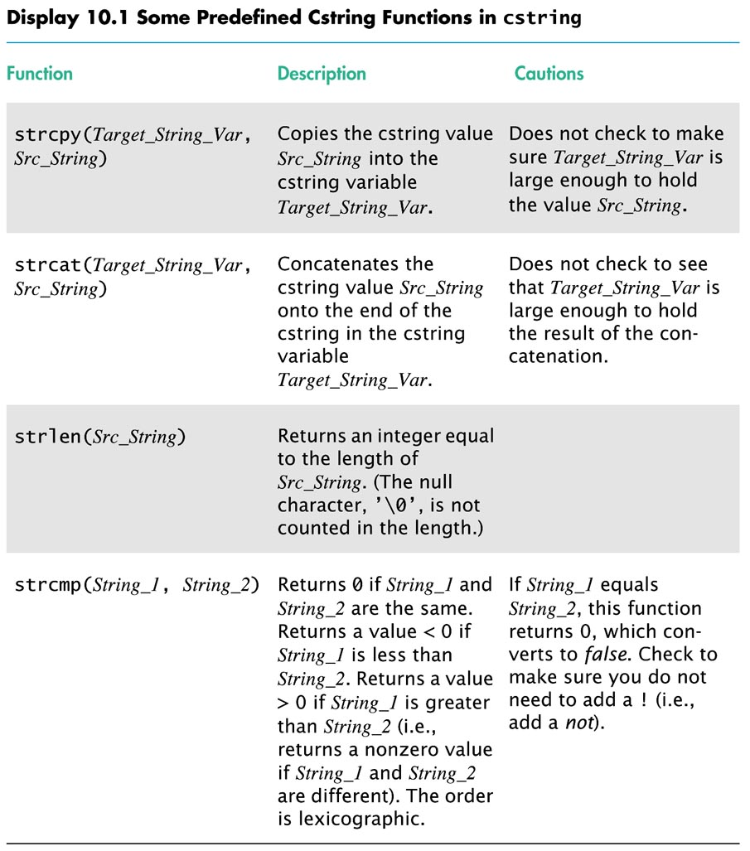
613

Slide 17
PITFALL:
Dangers in Using Functions from <cstring>
There is a very real danger associated with the functions strcpy and strcat.
Both these functions copy characters until a null character is found in the source string, without regard to whether space is available in the target.
If there is not space in the target, strcpy and strcat will happily overwrite any variables in memory beyond the target array.
This may be some of your variables, or it could be something that your system depends on to run correctly.
There could be no effect what so ever.
There could be a segmentation violation or illegal operation error, with your program crashing, and no further problems.
The operating system could crash and burn.
Nothing apparent may happen. But the next application started could crash and burn on loading. Be careful.

Slide 18
Defining cstring functions
The strcpy and strcat functions have problems.
The Standard Library defines versions that have an additional parameter that can avoid some of the problems.
To learn to write safe cstring functions, we write a string_copy function with an additional parameter to make the function safer.
The added parameter takes an argument that is the declared size of the target argument.

Slide 19
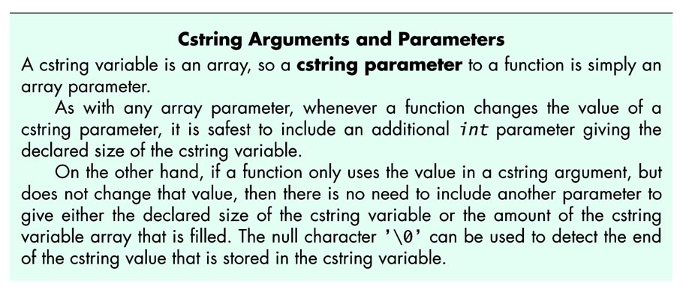
617

Slide 20
Display 10.2 The function string_copy (1 of 2)
//Program to demonstrate the function string_copy
#include <iostream>
#include <cstring>
void string_copy(char target[ ], const char source[ ], int target_size);
//Precondition: target_size is the declared size of the cstring variable target.
//The array source contains a cstring value terminated with ’\0’.
//Postcondition: The value of target has been set to the cstring value in source,
//provided the declared size of target is large enough. If target is not large
//enough to hold the entire cstring, a cstring equal to as much of the value of
//source as will fit is stored in target.
int main( )
{
using namespace std;
char short_string[11]; //Can hold cstrings of up to 10 characters.
string_copy(short_string, "Hello", 11);
cout << short_string << "STRING ENDS HERE.\n";
char long_string[ ] = "This is rather long.";
string_copy(short_string, long_string, 11);
cout << short_string << "STRING ENDS HERE.\n";
return 0;
}

Slide 21
Display 10.2 The fucntion string_copy (2 of 2)
//Uses header file cstring or string.h:
void string_copy(char target[ ], const char source[ ], int target_size)
{
using namespace std;
int new_length = strlen(source);
if (new_length > (target_size - 1))
new_length = target_size - 1; //That is all that will fit.
int index;
for (index = 0; index < new_length; index++)
target[index] = source[index];
target[index] = '\0';
}

Slide 22
cstring Input and Output (1 of 3)
cstrings may be output using the insertion operator <<
cout << short_string << “STRING ENDS HERE.\n”;
cstrings may receive input using the extraction operator >>
cin >> short_string >> some_other_string;
HOWEVER: Remember that extraction ignores all white space, and that extraction from istream objects stops at whitespace.
Whitespace is blanks, tabs, and line breaks.
The code
char a[80], b[80];
cin >> a >> b ;
cout << a << b << “END OF OUTPUT.\n”;
produces a dialog like:
Do be do to you!
DobeEND OF OUTPUT.

Slide 23
cstring Input and Output (2 of 3)
To get an entire line, you can write a loop to extract the line a word at a time, but this won’t read the blanks.
To get an entire line, you can use the predefined member getline.
getline has two arguments: a cstring and a number of characters to extract to the cstring, allowing for the null terminator.
Typically this is the declared size of the variable
Example: This code
char a[80];
cin.getline(a, 80);
cout << a << “END OF OUTPUT.\n”;
produces a dialog like:
Do be do to you!
Do be do to you!END OF OUTPUT.

Slide 24
cstring Input and Output (3 of 3)
The getline member function stops reading when a number of characters equal to the second argument have been read:
Example: This code
char a[80];
cin.getline(a, 5);
cout << a << “END OF OUTPUT.\n”;
produces a dialog like:
These cstring i/o techniques work the same for file i/o:
If in_stream has been declared and connected to a file, this code will input 79 or fewer characters (up to the end of line) into cstring variable a.
char a[80];
in_stream.getline(a, 80);
Dobedo to you!
DobeEND OF OUTPUT.

Slide 25
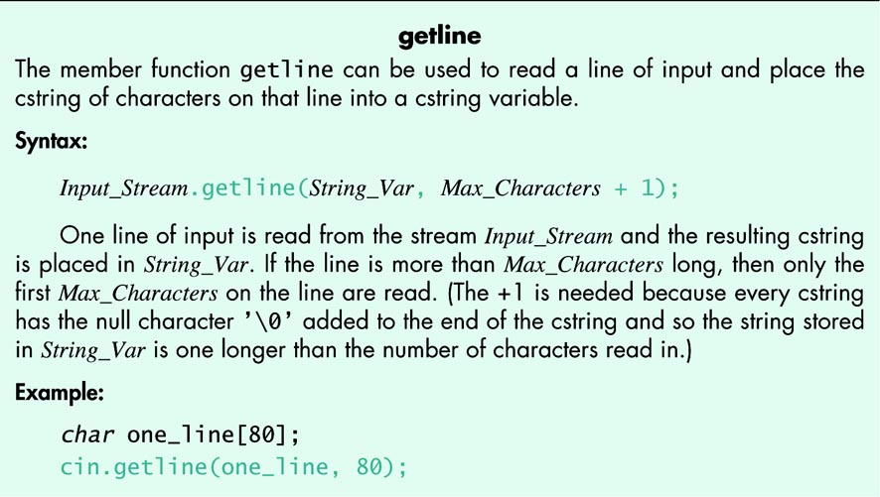
621

Slide 26
cstring-to-number Conversions and Robust Input (1 of 3)
‘1’, “1” and 1 are different.
1 is a int constant, also called a literal.
‘1’ is a char constant. It occupies one byte and is represented by some encoding. In C++ the value is the ASCII encoding, which has the decimal value 49.
(There is a new encoding called unicode characters. The C++ type that holds unicode is wchar_t. You study this in later courses.)
“1” is a cstring constant. It occupies two bytes, one for the encoding of the character 1 and one for the null terminator.
In a program in any language, you cannot ignore the difference between these objects.
Robust numeric input may be written by inputting a cstring, extracting the digit characters and building the number from the digits.

Slide 27
cstring-to-number Conversions and Robust Input (2 of 3)
Once you have a cstring containing the digits that represent an int, use the predefined function atoi
atoi is named and pronounced: Ascii TO Integer)
atoi takes a cstring argument and returns the int value represented by the digit characters in cstring.
atoi returns 0 if the cstring contains a non-digit character.
Example: atoi(“#37”) returns 0.
The atoi function is declared in the <cstdlib> header.
Display 10.3 has two utility functions:
  read_and_clean that inputs a string, ignoring any non-digits entered.
  new_line that discards all input remaining on the line.

Slide 28
cstring-to-number Conversions and Robust Input (3 of 3)
The function atof is named and pronounced Ascii TO Floating point.
atof is similar to atoi. It converts its cstring argument to the double value the cstring represents. Like atoi, the function atof returns 0.0 if the cstring argument does not represent to a double.
Display 10.3 demonstrates read_and_clean, and Display 10.4 is demonstrates Robust Input Functions

Slide 29
Display 10.3 cstrings to Integers (1 of 3)
//Demonstrates the function read_and_clean.
#include <iostream>
#include <cstdlib>
#include <cctype>
void read_and_clean(int& n);
//Reads a line of input. Discards all symbols except the digits. Converts
//the cstring to an integer and sets n equal to the value of this integer.
void new_line( );
//Discards all the input remaining on the current input line.
//Also discards the '\n' at the end of the line.
int main( )
{
using namespace std;
int n;
char ans;
do
{
cout << "Enter an integer and press return: ";
read_and_clean(n);
cout << "That string converts to the integer " << n << endl;
cout << "Again? (yes/no): ";
cin >> ans;
new_line( );
} while ( (ans != 'n') && (ans != 'N') );
return 0;
}

Slide 30
Display 10.3 cstrings to Integers (2 of 3)
//Uses iostream, cstdlib, and cctype:
void read_and_clean(int& n)
{
using namespace std;
const int ARRAY_SIZE = 6;
char digit_string[ARRAY_SIZE];
char next;
cin.get(next);
int index = 0;
while (next != '\n')
{
if ( (isdigit(next)) && (index < ARRAY_SIZE - 1) )
{
digit_string[index] = next;
index++;
}
cin.get(next);
}
digit_string[index] = '\0';
n = atoi(digit_string);
}

Slide 31
Display 10.3 cstrings to Integers (3 of 3)
//Uses iostream:
void new_line( )
{
using namespace std;
char symbol;
do
{
cin.get(symbol);
} while (symbol != '\n');
}

Slide 32
Display 10.4 Robust Input Functon (1 of 4)
//Demonstration program for improved version of get_int.
#include <iostream>
#include <cstdlib>
#include <cctype>
void read_and_clean(int& n);
//Reads a line of input. Discards all symbols except the digits. Converts
//the cstring to an integer and sets n equal to the value of this integer.
void new_line( );
//Discards all the input remaining on the current input line.
//Also discards the '\n' at the end of the line.
void get_int(int& input_number);
//Gives input_number a value that the user approves of.
int main( )
{
using namespace std;
int input_number;
get_int(input_number);
cout << "Final value read in = " << input_number << endl;
return 0;
}

Slide 33
Display 10.4 Robust Input Functon (2 of 4)
//Uses iostream and read_and_clean:
void get_int(int& input_number)
{
using namespace std;
char ans;
do
{
cout << "Enter input number: ";
read_and_clean(input_number);
cout << "You entered " << input_number
<< " Is that correct? (yes/no): ";
cin >> ans;
new_line( );
} while ((ans != 'y') && (ans != 'Y'));
}

Slide 34
Display 10.4 Robust Input Functon (3 of 4)
//Uses iostream, cstdlib, and cctype:
void read_and_clean(int& n)
{
using namespace std;
const int ARRAY_SIZE = 6;
char digit_string[ARRAY_SIZE];
char next;
cin.get(next);
int index = 0;
while (next != '\n')
{
if ( (isdigit(next)) && (index < ARRAY_SIZE - 1) )
{
digit_string[index] = next;
index++;
}
cin.get(next);
}
digit_string[index] = '\0';
n = atoi(digit_string);
}

Slide 35
Display 10.4 Robust Input Functon (4 of 4)
//Uses iostream:
void new_line( )
{
using namespace std;
char symbol;
do
{
cin.get(symbol);
} while (symbol != '\n');
}

Slide 36
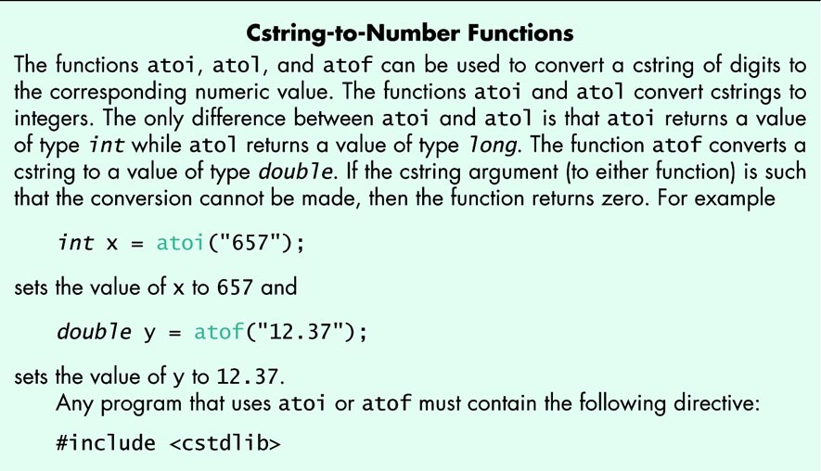
626

Slide 37
10.2 Multidimensional Arrays
Multidimensional Array Basics (1 of 2)
It is useful to have an array with more than one index. In C++, this is implemented using an array with an array type as base type.
Such an array is declared as following:
char page[30][100];
There are 30*100 indexed variables for this array. The indexed variables for this array are:
page[0][0], page[0][0], . . . . page[0][99]
page[1][0], page[1][1], . . . . page[1][99]
page[2][0], page[2][1], . . . . page[2][99]
. . .
. . .
. . .
page[29][0], page[29][1], . . . page[29][99]

Slide 38
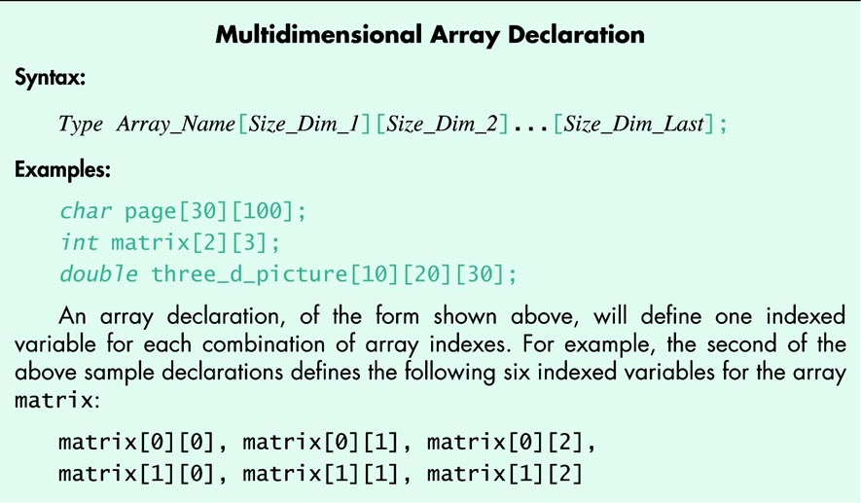
628

Slide 39
Multidimensional Array Basics (2 of 2)
We said that a two-dimensional array is an array with a base type that is an array type. In other words, two-dimensional array is an array of arrays.
The array
char page[30][100];
is a one dimensional array of size 30, whose base type is an array of size 100 with base type char.
Each entry in the array of size 30 is an array of char of size 100.
Most of the time the programmer can treat a two-dimensional array as if it were an array with two indices.
There are two situations where being an arrays of arrays is evident:
One is when a function with an array parameter for a two dimensional array:
void display( const char p[ ][100], int size);
With a two-dimensional array parameter the first dimension is ignored even if specified, and the compiler does not use it. This necessitates a size parameter.
This makes sense if you think of the multidimensional array parameter as an array of arrays. The first dimension is the index, the rest describe the base type.
With a higher-dimension array parameters the first dimension is (usually) not specified, but all the rest of the dimensions must be specified.

Slide 40
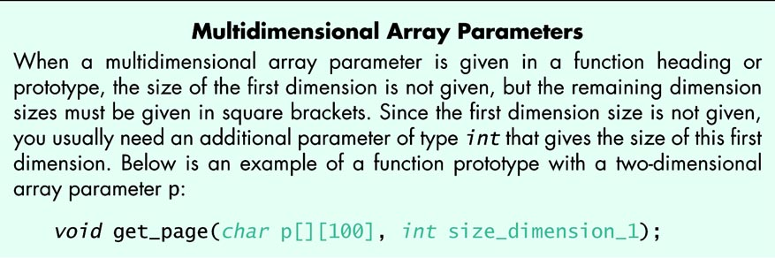
630

Slide 41
A Programming Example
A Two-Dimensional Grading Program.
Display 10.5 presents a program that uses a two-dimensional array named grade to store then display grade records for a small class.
The first index designates a student, the second designates a grade.
The grade of student 4 on quiz 1 is recorded in grade[3][0]
The program has an array, quiz_ave to hold a list of class averages for each quiz over all student grades in the class, and an array st_ave to hold a list of student averages over the quizes that student has taken.

Slide 42
630

Slide 43
Display 10.5 Two-dimensional Array (1 of 5)
//Reads quiz scores for each student into the two-dimensional array grade (but the input
//code is not shown in this display). Computes the average score for each student and
//the average score for each quiz. Displays the quiz scores and the averages.
#include <iostream>
#include <iomanip>
const int NUMBER_STUDENTS = 4, NUMBER_QUIZZES = 3;
void compute_st_ave(const int grade[][NUMBER_QUIZZES], double st_ave[]);
//Precondition: Global constant NUMBER_STUDENTS and NUMBER_QUIZZES
//are the dimensions of the array grade. Each of the indexed variables
//grade[st_num-1, quiz_num-1] contains the score for student st_num on quiz quiz_num.
//Postcondition: Each st_ave[st_num-1] contains the average for student number
//stu_num.

Slide 44
Display 10.5 Two-dimensional Array (2 of 5)
void compute_quiz_ave(const int grade[][NUMBER_QUIZZES], double quiz_ave[ ]);
//Precondition: Global constant NUMBER_STUDENTS and NUMBER_QUIZZES
//are the dimensions of the array grade. Each of the indexed variables
//grade[st_num-1, quiz_num-1] contains the score for student st_num on quiz quiz_num.
//Postcondition: Each quiz_ave[quiz_num-1] contains the average for quiz numbered
//quiz_num.
void display(const int grade[][NUMBER_QUIZZES],
const double st_ave[ ], const double quiz_ave[ ]);
//Precondition: Global constant NUMBER_STUDENTS and NUMBER_QUIZZES are the
//dimensions of the array grade. Each of the indexed variables grade[st_num-1,
//quiz_num-1] contains the score for student st_num on quiz quiz_num. Each
//st_ave[st_num-1] contains the average for student stu_num. Each
//quiz_ave[quiz_num-1] contains the average for quiz numbered quiz_num.
//Postcondition: All the data in grade, st_ave, and quiz_ave have been output.

Slide 45
Display 10.5 Two-dimensional Array (3 of 5)
int main( )
{
using namespace std;
int grade[NUMBER_STUDENTS][NUMBER_QUIZZES];
double st_ave[NUMBER_STUDENTS];
double quiz_ave[NUMBER_QUIZZES];
grade[0][0] = 10; grade[0][1] = 10; grade[0][2] = 10;
grade[1][0] = 2; grade[1][1] = 0; grade[1][2] = 1;
grade[2][0] = 8; grade[2][1] = 6; grade[2][2] = 9;
grade[3][0] = 8; grade[3][1] = 4; grade[3][2] = 10;
compute_st_ave(grade, st_ave);
compute_quiz_ave(grade, quiz_ave);
display(grade, st_ave, quiz_ave);
return 0;
}

Slide 46
Display 10.5 Two-dimensional Array (4 of 5)
void compute_st_ave(const int grade[ ][NUMBER_QUIZZES], double st_ave[ ])
{
for (int st_num = 1; st_num <= NUMBER_STUDENTS; st_num++)
{//Process one st_num:
double sum = 0;
for (int quiz_num = 1; quiz_num <= NUMBER_QUIZZES; quiz_num++)
sum = sum + grade[st_num-1][quiz_num-1];
//sum contains the sum of the quiz scores for student number st_num.
st_ave[st_num-1] = sum/NUMBER_QUIZZES;
//Average for student st_num is the value of st_ave[st_num-1]
}
}
void compute_quiz_ave(const int grade[][NUMBER_QUIZZES], double quiz_ave[])
{
for (int quiz_num = 1; quiz_num <= NUMBER_QUIZZES; quiz_num++)
{//Process one quiz (for all students):
double sum = 0;
for (int st_num = 1; st_num <= NUMBER_STUDENTS; st_num++)
sum = sum + grade[st_num-1][quiz_num-1];
//sum contains the sum of all student scores on quiz number quiz_num.
quiz_ave[quiz_num-1] = sum/NUMBER_STUDENTS;
//Average for quiz quiz_num is the value of quiz_ave[quiz_num-1]
}
}
//Uses iostream and iomanip:
void display(const int grade[][NUMBER_QUIZZES],
const double st_ave[], const double quiz_ave[])
{
using namespace std;
using namespace std;
cout.setf(ios::fixed);
cout.setf(ios::showpoint);
cout.precision(1);
cout << setw(10) << "Student"
<< setw(5) << "Ave"
<< setw(15) << "Quizzes\n";
for (int st_num = 1; st_num <= NUMBER_STUDENTS; st_num++)
{//Display for one st_num:
cout << setw(10) << st_num
<< setw(5) << st_ave[st_num-1] << " ";
for (int quiz_num = 1; quiz_num <= NUMBER_QUIZZES; quiz_num++)
cout << setw(5) << grade[st_num-1][quiz_num-1];
cout << endl;
}
cout << "Quiz averages = ";
for (int quiz_num = 1; quiz_num <= NUMBER_QUIZZES; quiz_num++)
cout << setw(5) << quiz_ave[quiz_num-1];
cout << endl;
}

Slide 47
Display 10.5 Two-dimensional Array (5 of 5)
//Uses iostream and iomanip:
void display(const int grade[ ][NUMBER_QUIZZES],
const double st_ave[ ], const double quiz_ave[ ])
{
using namespace std;
using namespace std;
cout.setf(ios::fixed);
cout.setf(ios::showpoint);
cout.precision(1);
cout << setw(10) << "Student"
<< setw(5) << "Ave"
<< setw(15) << "Quizzes\n";
for (int st_num = 1; st_num <= NUMBER_STUDENTS; st_num++)
{//Display for one st_num:
cout << setw(10) << st_num
<< setw(5) << st_ave[st_num-1] << " ";
for (int quiz_num = 1; quiz_num <= NUMBER_QUIZZES; quiz_num++)
cout << setw(5) << grade[st_num-1][quiz_num-1];
cout << endl;
}
cout << "Quiz averages = ";
for (int quiz_num = 1; quiz_num <= NUMBER_QUIZZES; quiz_num++)
cout << setw(5) << quiz_ave[quiz_num-1];
cout << endl;
}

Slide 48
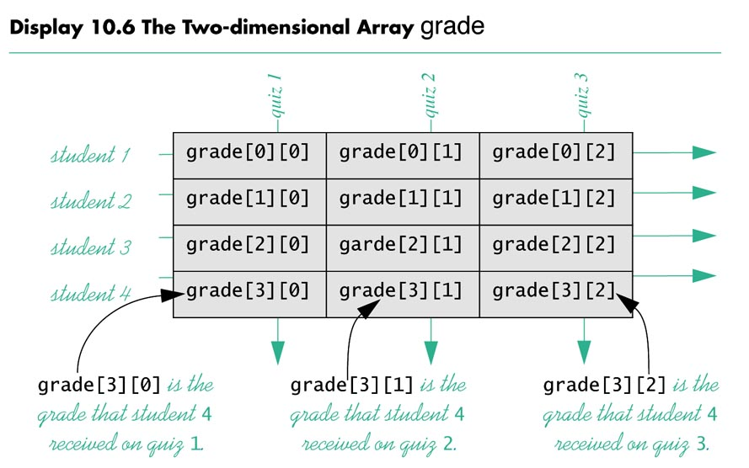
634_01

Slide 49
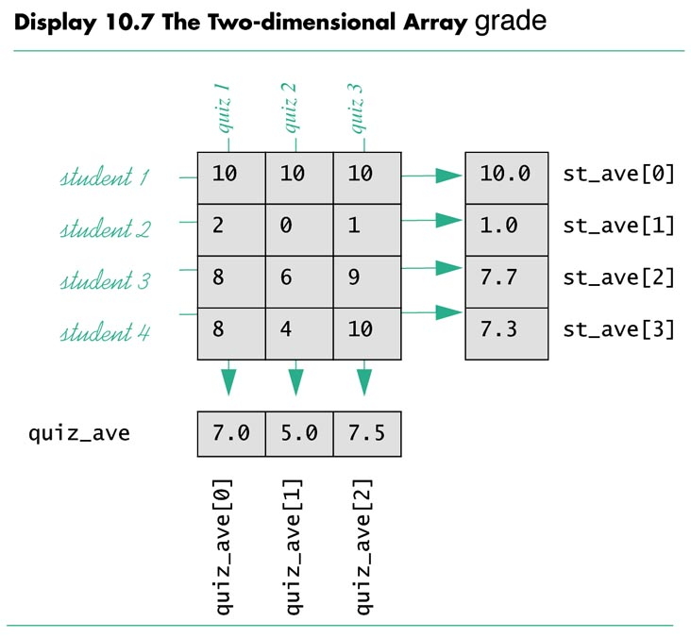
634_02

Slide 50
Arrays of cstrings
A cstring is an array of base type char.
Consequently an array of cstrings is a two-dimensional array of base type char.
A cstring must hold a null terminator, ‘\0’, so each element of this array of 5 cstrings can hold at most 19 characters:
char name[5][20]
Like any array, you can manipulate an array of cstrings by using both index values in nested loops.
It is nicer to treat the cstrings as entities:
cout << “Enter 5 names, one per line:\n “;
for (int index = 0; index < 5; index++)
cin.getline(name[index], 20);
Output to the screen is also straightforward:
for (int index = 0; index < 5; index++)
cout << name[index] << endl;

Slide 51
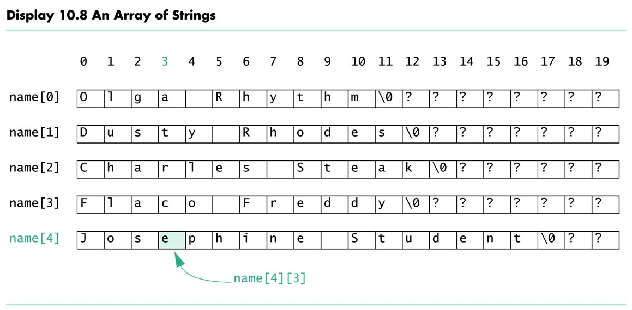
636

Slide 52
10.3 The C++ Standard string class
Using cstrings with predefined cstring functions is not as safe as we would like.
Using strcpy to copy a longer cstring to another (shorter) cstring will overwrite memory that may be important to your program. If you are fortunate, it will be only your program that is the casualty. Your operating system may crash.

Slide 53
Interface for the Standard Class string (1 of 4)
The Standard Library supplied class string provides far more utility
than the cstrings C++ gets by way of its C heritage.
Class strings behave very much like built-in data types and are far
safer than cstrings.
Let s1, s2, and s3 be objects of class string, and suppose s1 and s2
have string values. Then + may be used for concatenation:
s3 = s1 + s2;
Additional space needed is allocated for s3 automatically.
The default constructor generates an empty string
There is a constructor that takes a cstring argument:
string phrase, word1(“Hello “), word2(“World”);
phrase = word1 + word2;
cout << phrase << endl;
The output will be
Hello World

Slide 54
Interface for the Standard Class string (2 of 4)
You can concatenate one string literal with a class string object:
string phrase, word1(“Hello“), word2(“World”);
phrase = word1 + “ “ + word2;
cout << phrase << endl;
The output will be
Hello World
This works because there is a constructor that converts from cstring to class string objects. C++ sees word1 + “ “, sees a string on the left of + looks for a string on the right of the +. Failing to find it, C++ looks and finds another overloading that has a cstring on the right. Finding such an overloading, it proceeds.
If such an overloading were not found, C++ would look for a constructor to convert from cstring to string.
An attempt such as
phrase = “Hello “ + “World “ + word2;
fails. The + operator groups from left to right, “Hello “ + “ World“ is done first. This fails because there is no concatenation operator for cstrings.

Slide 55
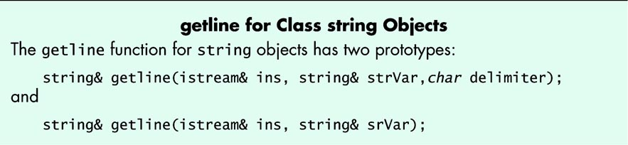
Interface for the Standard Class string (3 of 4)
The class string overloads the << and >> operators with stream left arguments and string right hand arguments with familiar behavior.
Overloaded >> operator skips leading whitespace and reads nonwhite characters up to the next white space.
To get an entire line of input for cstrings, we used the getline member of the istream class.
To get an entire line of input for class string objects, we use a stand alone version of getline.

Slide 56
Interface for the Standard Class string (4 of 4)
Characteristic use of the getline function follow:
#include <iostream>
#include <string>
using namespace std;
//. . .
string str1;
getline(cin, str1);
//insert into str12 all input up to ‘\n’
//getline discards the ‘\n’
NOTE THAT class string objects do not range check index values.
If you want range checked indexing into strings, use the string member function at(int_index).
str1.at(9); //Checks index value 9 for legality in str1.
//If legal,returns the character at index value 9.

Slide 57
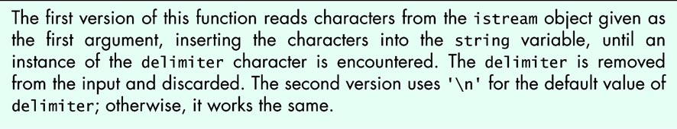
642

Slide 58
Pitfall
Code That Depends on Order of Evaluation is Illegal. (1 of 2)
ANSI C++ does not specify the order of evaluation for terms in an expression. Writing code that depends on the order of evaluation is illegal. Unfortunately, most compilers do not catch this error.
Example:
(a + b) * (c + d)
There is no guarantee whether a + b or c + d is evaluated first, nor does it make any difference in this case.
HOWEVER -- There is a considerable difference here:
int i = 0;
cout << i << “ “ << i++ << endl;
// Some compilers evaluate the expressions i and i++ right
// to left before calling the operator << overloading,
// giving the result 1 0
// A different compiler might give the result 0 1

Slide 59
Pitfall
Code That Depends on Order of Evaluation is Illegal. (2 of 2)
If you need such code, write it so that the sequence of evaluations of the operations can be guaranteed:
int i = 0;
cout << i << “ “ ;
i++;
cout << i++ << endl;
// Some compilers evaluate the expressions i and i++ right
// to left before calling the operator << overloading,
// giving the result 1 0

Slide 60
Programming Tip
The Ignore Member Function
With cin >> intVariable, everything entered beyond the integer just read in will still be available on the input stream, ready for further extraction. This includes the return key pressed to make the line of data available.
This data will cause the getline function to misbehave.
We presented one fix, the new_line function.
A standard fix is to use the predefined cin member function ignore, whose prototype is
istream& ignore( int count, char delimiter);
This function will read count characters unless it reads a delimiter character first. All the characters are discarded.

Slide 61
Pitfall
Mixing cin >> variable and getline can lose input.
Careless mixed use of cin >> variable and getline can lose data in strange ways.
cin >> variable skips leading whitespace and leaves the newline (‘\n’) character on the input stream.
getline reads everything up to and including the ‘\n’, keeps the data and discards the ‘\n’.
Use of cin >> variable leaves a ‘\n’ that makes a getline see an empty string.
Use the new_line function from the text or
cin.ignore(10000, ‘\n’);
to discard up to 10,000 characters or up to the newline.

Slide 62
Programming Example
Palendrome Testing (1 of 2)
Chapter 9 Programming Assignment 1 requests a program to determine whether a string is a palindrome.
A palendrom has the same characters read front to back as it does read back to front. Examples (ignore punctuation, case, and blanks):
Able was I ere I saw Elba.
Madam, I’m Adam.
Rats live on no evil star.
The program uses the following string facilties:
string str; // default constructor - defines empty string
getline(cin, str); // fetches an entire line of input
isPal(str) // boolean function that tests for palendrom

Slide 63
Programming Example
Palendrome Testing (2 of 2)
The isPal funtion
defines a string containing the characters we want removed (punctuation and space)
Makes a working copy (Str) of the reference parameter
forces working copy to all lower case
makes a copy (lowerStr) of working string with punctuation removed
returns the results of comparing work reverse(working string)
makeLower cycles through all the characters in its parameter, returning a string all of whose characters has any uppercase characters replaced by corresponding lowercase letters.
removePunct uses the string member function substr and find.

Slide 64
Display 10.10 Palindrome Testing Program (1 of 5)
//test for palindrome property
#include <iostream>
#include <string>
#include <cctype>
using namespace std;
void swap(char& lhs, char& rhs);
//swaps char args corresponding to parameters lhs and rhs
string reverse(const string& str);
//returns a copy of arg corresponding to parameter
//str with characters in reverse order.
string removePunct(const string& src,
const string& punct);
//returns copy of string src with characters
//in string punct removed
string makeLower (const string& s);
//returns a copy of parameter s that has all upper case
//characters forced to lower case, other characters unchanged.
//Uses <string>, which provides tolower
bool isPal(const string& this_String);
//uses makeLower, removePunct.
//if this_String is a palindrome,
// return true;
//else
// return false;

Slide 65
Display 10.10 Palindrome Testing Program (2 of 5)
int main()
{
string str;
cout << "Enter a candidate for palindrome test "
<< "\nfollowed by pressing return.\n";
getline(cin, str);
if (isPal(str))
cout << "\"" << str + "\" is a palindrome ";
else
cout << "\"" << str + "\" is not a palindrome ";
cout << endl;
return 0;
}
void swap(char& lhs, char& rhs)
{
char tmp = lhs;
lhs = rhs;
rhs = tmp;
}

Slide 66
Display 10.10 Palindrome Testing Program (3 of 5)
string reverse(const string& str)
{
int start = 0;
int end = str.length();
string tmp(str);
while (start < end)
{
end--;
swap(tmp[start], tmp[end]);
start++;
}
return tmp;
}
//Returns arg that has all upper case characters forced to lower case,
//other characters unchanged. makeLower uses <string>, which provides
//tolower
string makeLower(const string& s) //uses <cctype>
{
string temp(s); //This creates a working copy of s
for (int i = 0; i < s.length(); i++)
temp[i] = tolower(s[i]);
return temp;
}

Slide 67
Display 10.10 Palindrome Testing Program (4 of 5)
//returns a copy of src with characters in punct removed
string removePunct(const string& src, const string& punct)
{
string no_punct;
int src_len = src.length();
int punct_len = punct.length();
for(int i = 0; i < src_len; i++)
{
string aChar = src.substr(i,1);
int location = punct.find(aChar, 0);
//find location of successive characters
//of src in punct
if (location < 0 || location >= punct_len)
no_punct = no_punct + aChar; //aChar not in punct -- keep it
}
return no_punct;
}

Slide 68
Display 10.10 Palindrome Testing Program (5 of 5)
//uses functions makeLower, removePunct.
//Returned value:
//if this_String is a palindrome,
// return true;
//else
// return false;
bool isPal(const string& this_String)
{
string punctuation(",;:.?!'\" "); //includes a blank
string str(this_String);
str = makeLower(str);
string lowerStr = removePunct(str, punctuation);
return lowerStr == reverse(lowerStr);
}

Slide 69
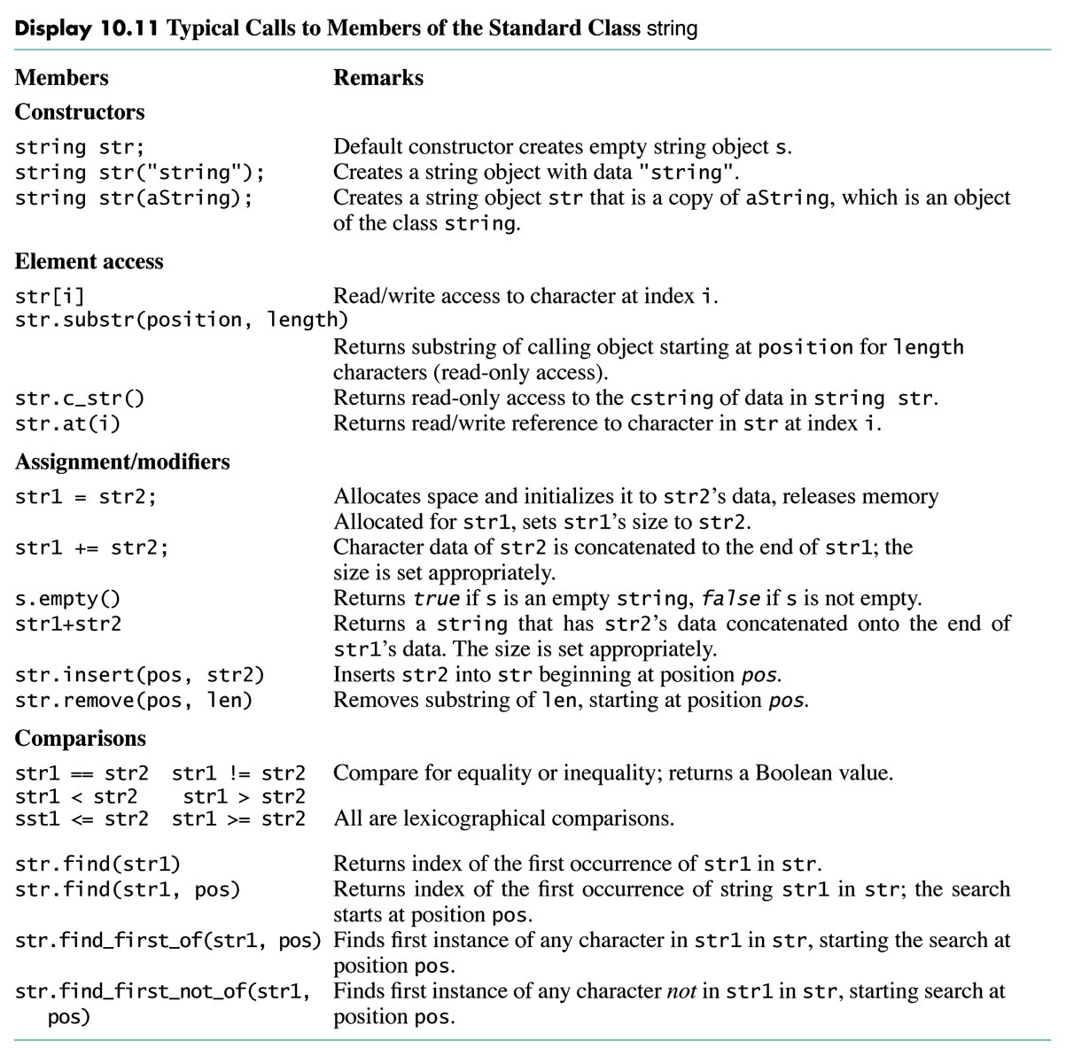
650

Slide 70
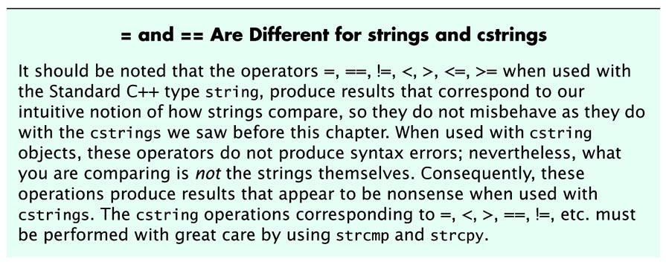
651

Slide 71
Arrays of string Revisited
Remember, string is a type that acts exactly like any other type.
You can have arrays whose base type is string:
string list[20];
This is an arrray of 20 string objects.
This array can be filled as follows:
cout << “Enter 20 names, one per line: \n”;
for (int i = 0; i < 20; i++)
getline(cin, list[i]);
Output is the same as for cstrings
for (int i = 0; i < 20; i++)
cout << list[i] << endl;

Slide 72
Namespaces Revisited
Display 10.12 is a version of Display 10.10 where we have handled the namespace issues differently.
Display 10.10 has only one using directive that applies to the entire file:
using namespace std;
In Display 10.12, we keep the scope of the using directives to a single function, and do not place using directives in swap because none is needed there.
Names in function headers are qualified with std::, as in std::string.
Alwasy use the technique your instructor suggests!

Slide 73
Display 10.12 Careful Namespace Usage (1 of 6)
//test for palindrome property
#include <iostream>
#include <string>
#include <cctype>
void swap(char& lhs, char& rhs);
//swaps char args corresponding to parameters lhs and rhs
std::string reverse(const std::string& str);
//returns a copy of arg corresponding to parameter
//str with characters in reverse order.
std::string removePunct(const std::string& src,
const std::string& punct);
//returns copy of string src with characters
//in string punct removed
std::string makeLower (const std::string& s);
//returns a copy of parameter s that has all upper case
//characters forced to lower case, other characters unchanged.
//Uses <string>, which provides tolower
bool isPal(const std::string& this_String);
//uses makeLower, removePunct.
//if this_String is a palindrome,
// return true;
//else
// return false;

Slide 74
Display 10.12 Careful Namespace Usage (2 of 6)
int main()
{
using namespace std;
string str;
cout << "Enter a candidate for palindrome test "
<< "\nfollowed by pressing return.\n";
getline(cin, str);
if (isPal(str))
cout << "\"" << str + "\" is a palindrome ";
else
cout << "\"" << str + "\" is not a palindrome ";
cout << endl;
return 0;
}

Slide 75
Display 10.12 Careful Namespace Usage (3 of 6)
void swap(char& lhs, char& rhs)
{
char tmp = lhs;
lhs = rhs;
rhs = tmp;
}
std::string reverse(const std::string& str)
{
using namespace std;
int start = 0;
int end = str.length();
string tmp(str);
while (start < end)
{
end--;
swap(tmp[start], tmp[end]);
start++;
}
return tmp;
}

Slide 76
Display 10.12 Careful Namespace Usage (4 of 6)
//Returns arg that has all upper case characters forced to lower case,
//other characters unchanged. makeLower uses <string>, which provides
//tolower
std::string makeLower(const std::string& s) //uses <cctype>)
{
using namespace std;
string temp(s); //This creates a working copy of s
for (int i = 0; i < s.length(); i++)
temp[i] = tolower(s[i]);
return temp;
}

Slide 77
Display 10.12 Careful Namespace Usage (5 of 6)
//returns a copy of src with characters in punct removed
std::string removePunct(const std::string& src, const std::string& punct)
{
using namespace std;
string no_punct;
int src_len = src.length();
int punct_len = punct.length();
for(int i = 0; i < src_len; i++)
{
string aChar = src.substr(i,1);
int location = punct.find(aChar, 0);
//find location of successive characters
//of src in punct
if (location < 0 || location >= punct_len)
no_punct = no_punct + aChar; //aChar not in punct -- keep it
}
return no_punct;
}

Slide 78
Display 10.12 Careful Namespace Usage (6 of 6)
//uses functions makeLower, removePunct.
//Returned value:
//if this_String is a palindrome,
// return true;
//else
// return false;
bool isPal(const std::string& this_String)
{
using namespace std;
string punctuation(",;:.?!'\" "); //includes a blank
string str(this_String);
str = makeLower(str);
string lowerStr = removePunct(str, punctuation);
return lowerStr == reverse(lowerStr);
}

Slide 79
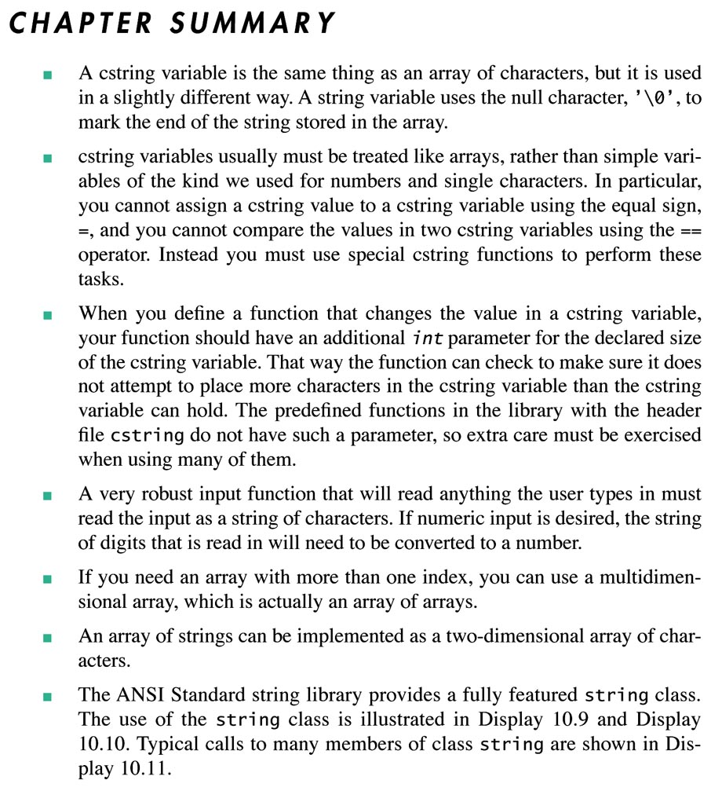
657-58

